Slide 1

Pipeline Pioneers
CIRCLE-4: LINUX AND GIT
Core Data Engineers
September 2025

Slide 2

Introduction
In this presentation, we’ll take a closer look at Parch and Posey, a fictional company that gives us real-world insights into business performance. Together, we’ll explore the factors that can boost profitability and streamline operations, uncovering strategies that every business can learn from.

Slide 3
Executive Summary
The analysis shows strong sales performance, with 6,912 orders generating $23.1M in revenue—an average of $3,348 per order. The Standard product led with 1.9M orders and $9.67M in revenue, confirming its role as the top revenue driver.
In online channels, Direct sales dominated ($639.7M), while Facebook ($103M) and Organic ($102M) also contributed significantly. Regionally, sales grew steadily from 2013–2016, peaking in 2016 across all regions before dropping sharply in 2017.
A strong positive relationship between order volume and revenue was observed, though the 2017 decline highlights the need for further review to sustain growth.

Slide 4
Regional
YoY
The regional sales analysis shows consistent growth from 2013 to 2016, peaking in 2016 with the Northeast leading at 1,196 orders worth nearly $4 million, followed by the Southeast (1,110 orders; $3.5M) and the West (968 orders; $3.6M). The Midwest also contributed significantly with 483 orders totaling $1.7M. In 2017, however, both orders and revenues dropped sharply across all regions.
The trend highlights a clear positive relationship between total orders and order value—as order volumes increased, revenues rose proportionally, while the 2017 decline confirmed how fewer orders directly translated into lower sales. Overall, 2016 stands out as the strongest year, driven by high order activity and robust revenue performance.

Slide 5
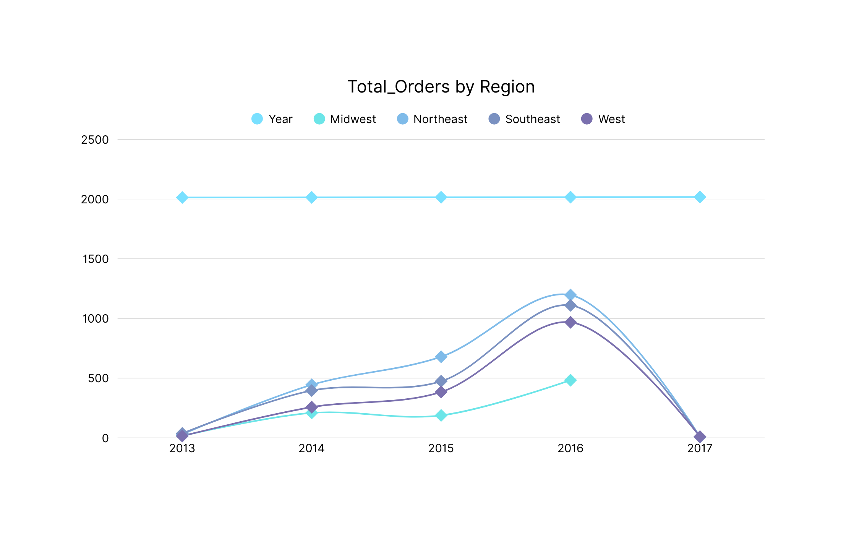

Slide 6
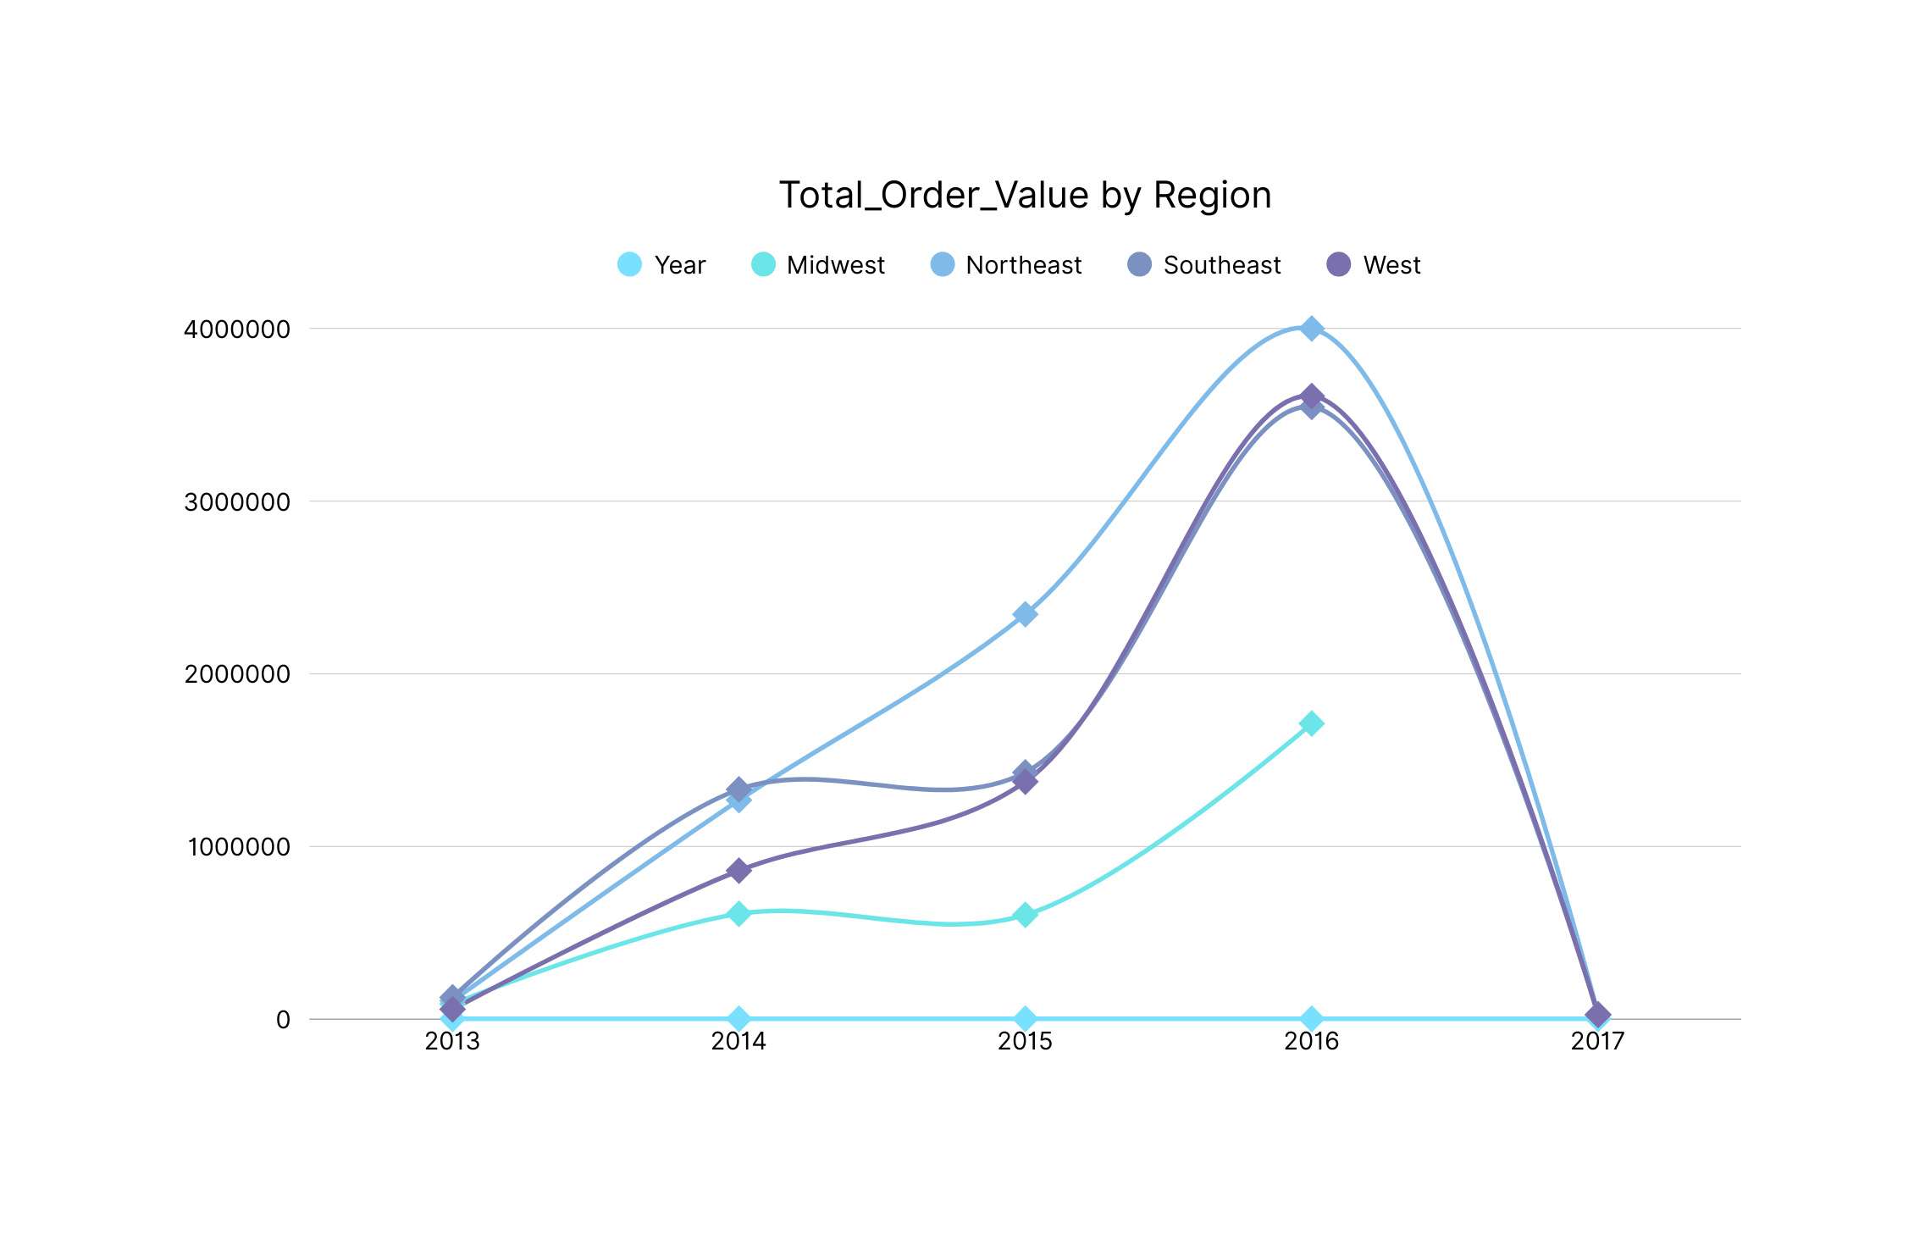

Slide 7
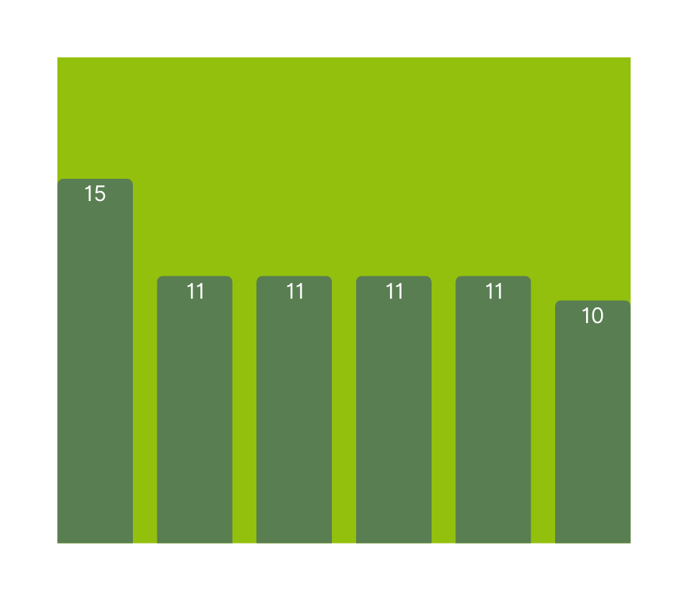

Customer Acquisition Metrics
Our analysis of customer acquisition metrics reveals that Georgianna Chisholm leads the way with 15 customers. Close behind, Earlie Schleusner, Calvin Ollison, Maryanna Fiorentino, Maren Musto, Dorotha Seawell, Micha Woodford, and Vernita Plump each secured 11 customers, while Brandie Riva and Hilma Busick followed with 10 customers apiece.
This performance underscores both standout individual achievements and steady team-wide contributions, reinforcing the company’s strong foundation for continued growth.

Slide 8
Top Customers
The sales performance analysis positions EOG Resources as the standout client, recording the highest purchase volume of 56,410 units and generating $382,873.30 in revenue. This establishes EOG Resources not only as the largest customer but also as a critical driver of overall profitability.
Mosaic follows closely with 49,246 units and $345,618.59, reinforcing its role as a reliable high-value partner, while IBM, with 47,506 units and $326,819.48, secures the third spot, underscoring the importance of strong corporate accounts in sustaining growth.
Completing the top five, General Dynamics contributed 43,730 units worth $300,694.79, and Republic Services added 40,833 units generating $293,861.14, both reflecting steady and dependable revenue streams that bolster financial stability.
Together, these top five accounts form the backbone of customer performance, representing a balanced mix of scale, consistency, and profitability. Their combined strength highlights the company’s ability to attract and retain high-value customers while also signaling opportunities to deepen engagement with these strategic partners.

Slide 9
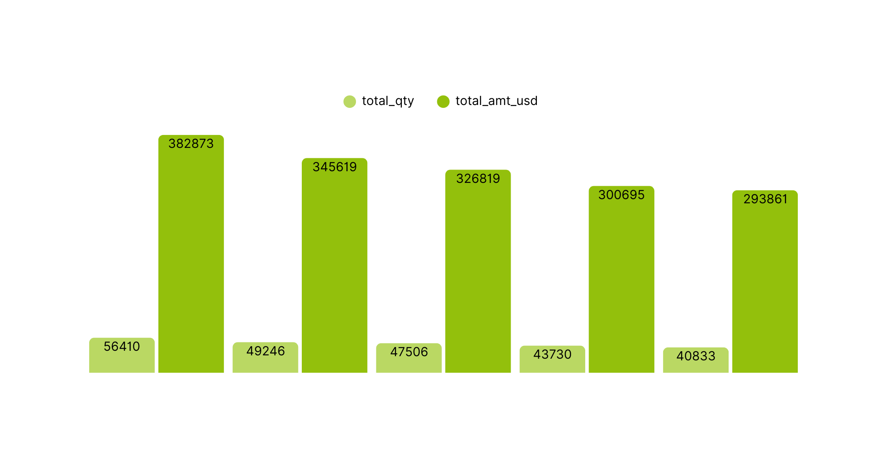
Top Customers

Slide 10
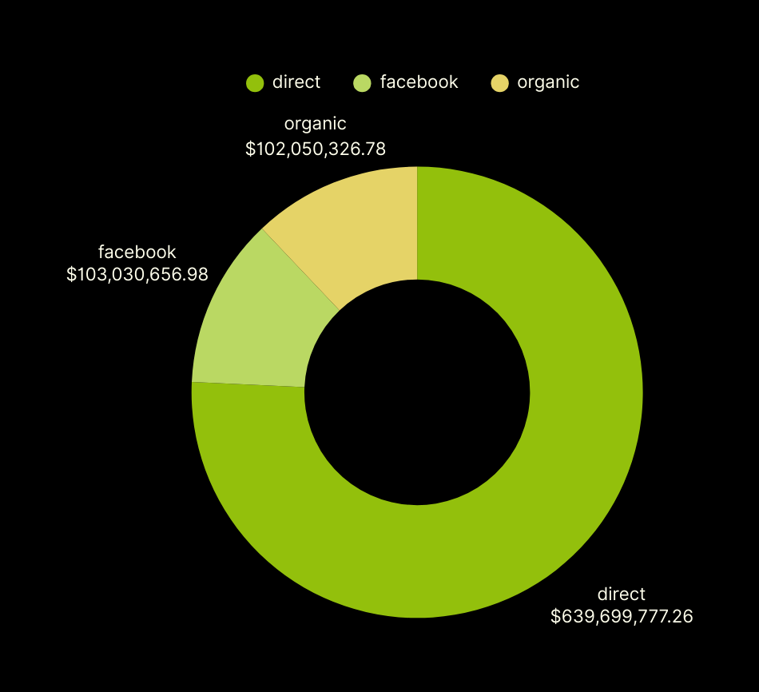
Online Sales Performance
The analysis shows the direct channel leading by a wide margin with $639.7 million, making it the backbone of revenue generation. Facebook and organic channels follow with $103.0 million and $102.1 million respectively, reflecting the growing role of digital platforms in expanding reach. Together, these results highlight a strong reliance on direct sales while also pointing to opportunities for growth through online engagement.

Slide 11
Orders and
Revenue
TOTAL ORDERS
6912
In a detailed assessment of overall sales performance, the company processed a total of 6,912 orders, generating an impressive $23,141,511.83 in revenue. This equates to an average of $3,347 per order, reflecting the high value of individual transactions and the efficiency of sales operations. The alignment between order volume and revenue underscores the company’s ability to sustain profitability through both scale and transaction quality, signaling a strong foundation for continued growth and long-term customer value.
TOTAL REVENUE
$23,141,511.83

Slide 12

In our assessment of product performance, the Standard paper emerged as the top performer with a remarkable 1,938,346 units ordered, generating a revenue of $9,672,346.54.
This strong demand highlights the product’s broad market appeal and reliability as a consistent revenue driver.
The alignment between its high order volume and significant revenue contribution underscores its pivotal role in the company’s portfolio, positioning it as a cornerstone for sustained profitability and competitive advantage.
Best Product

Slide 13
Suggestion & Addition
To sustain growth, the company should:
Strengthen relationships with top clients (EOG Resources, Mosaic, IBM) through dedicated account management and tailored solutions.
Diversify its customer base to reduce reliance on a few high-value accounts.
Enhance digital sales channels, especially on Facebook and organic platforms, to complement direct sales and capture new markets.
Introduce bundled offers or premium variations based on the success of Standard paper to maximize profitability.
Leverage upselling and cross-selling strategies to increase the average revenue per order of $3,347.
Monitor customer feedback and market trends to align offerings with demand for long-term competitiveness and profitability.

Slide 14
Thank You
FOR YOUR ATTENTION
Pipeline Pioneers
September 2024

